Slide 1

ShopNow
E-Commerce Website
🛒 Online Shopping
🔔 Real-time Notifications
A Modern Shopping Platform — Powered by AI
📦 Order Tracking
Presented by:
🔐 Secure Checkout
Shabothu Vrishank
📱 Responsive Design
Full-Stack Developer
2026

Slide 2




Introduction
02
What is ShopNow?
Online Shopping
ShopNow is a feature-complete, AI-assisted e-commerce platform inspired by industry leaders like Puma and Nike. Built as a responsive single-page application, it delivers a premium online shopping experience without requiring any backend infrastructure.
12 products, 8 categories
Notifications
Toast alerts & order updates
Purpose
To simulate a real-world e-commerce site with complete shopping features — from browsing products and managing a wishlist to secure checkout and order tracking — showcasing modern web development and AI-assisted coding practices.
Smart Search
Filter, sort & discover
Secure Checkout
3-step payment flow
ShopNow — E-Commerce Website | Shabothu Vrishank

Slide 3
Objectives
03
User-Friendly Interface
Secure Authentication
01
02
Intuitive navigation, category browsing, and responsive layout for all devices
Login, registration, password reset, and admin panel with role-based access
Fast & Smooth Checkout
Diverse Product Catalog
03
04
3-step checkout with address, payment, and order confirmation in seconds
12 real products across 8 categories with detailed specs, images & reviews
AI-Assisted Development
Performance & Scalability
05
06
All code generated with AI prompts — demonstrating modern dev workflows
Zero-build setup; ready to scale with Next.js, PostgreSQL, and Stripe
ShopNow — E-Commerce Website | Shabothu Vrishank

Slide 4




Stakeholders
04
Customers
Admin
Developers
Business Owner
Browse & purchase products
View dashboard stats
Build & maintain codebase
Define product strategy
Manage wishlist & cart
Manage product catalog
Integrate AI tools & prompts
Set pricing & discounts
Track orders & view history
Monitor all orders
Ensure performance
Analyze revenue metrics
Save multiple addresses
Handle user accounts
Write tests & documentation
Plan marketing campaigns
Write product reviews
Update order statuses
Deploy & monitor
Review customer feedback
ShopNow — E-Commerce Website | Shabothu Vrishank

Slide 5
Programming Languages, Tools & Software
05
Core Languages
Libraries & Frameworks
Tools & Software
HTML5
React 18 (CDN)
VS Code
Semantic structure & layout
Component-based UI via vanilla CDN
Primary code editor
CSS3
Lucide React
Chrome / Edge
Styling, animations, responsive grids
Icon library for UI components
Browser testing & DevTools
JavaScript (ES6+)
CSS Variables
Claude AI
Dynamic UI logic & state management
Design tokens for dark theme
AI-assisted code generation
ShopNow — E-Commerce Website | Shabothu Vrishank

Slide 6
AI Prompts Used to Generate Code
06
Part 1 of 2
01
Homepage Structure
"Build a full Amazon-like e-commerce homepage in a single HTML file using React via CDN. Include a navbar with logo, search bar, cart icon, and auth buttons. Add a hero banner carousel with 3 rotating promotional slides, a category grid with 8 icons, featured products section, and a trending products section with discount badges."
02
Authentication System
"Add a complete authentication system: login form, registration form with name/email/password, and a password reset flow. Include form validation, error messages, and transition between auth views. Store users in localStorage and support an admin account (admin@shopnow.com / admin123)."
03
Product Catalog & Filters
"Create a products page with a sidebar filter panel: category filter checkboxes, price range slider, minimum rating filter. Add sort options (Popular, Highest Rated, Price Low–High, Price High–Low). Show products in a responsive grid with image, name, rating stars, price, original price, and discount badge."
ShopNow — E-Commerce Website | Shabothu Vrishank

Slide 7
AI Prompts Used to Generate Code
06
Part 2 of 2
04
Cart & Checkout Flow
"Build a 3-step checkout: Step 1 — address selection with option to add new; Step 2 — payment method selection (Card, UPI, Cash on Delivery); Step 3 — order summary with confirm button. Support promo code WELCOME20 for 20% discount. Show savings, tax (8%), and shipping."
05
Admin Dashboard
"Create an admin panel accessible only to admin@shopnow.com. Show stat cards: total products, orders, revenue, users. Include product management (add new product, delete existing), order management table with order IDs and statuses, and user management section."
06
Data & Persistence
"Design a data.js file with 12 real products across 8 categories (Electronics, Fashion, Home, Books, Sports, Beauty, Toys, Grocery). Each product should have: name, price, originalPrice, rating, reviewCount, image URL (Unsplash), badge, specs object, tags array, and 2-3 user reviews."
ShopNow — E-Commerce Website | Shabothu Vrishank

Slide 8






Workflow Flowchart
07
1
2
3
4
5
6
User Visits
ShopNow
Login /
Register
Browse
Products
Add to
Cart
Checkout
& Payment
Order
Confirmed
Each step is fully functional — from guest browsing to post-order tracking in the user dashboard.
Registration
Filter & Sort
Cart Features
Payment Methods
Name, Email, Password + Validation
Category, Price Range, Rating
Qty Control, Promo Code WELCOME20
Card, UPI, Cash on Delivery
ShopNow — E-Commerce Website | Shabothu Vrishank

Slide 9
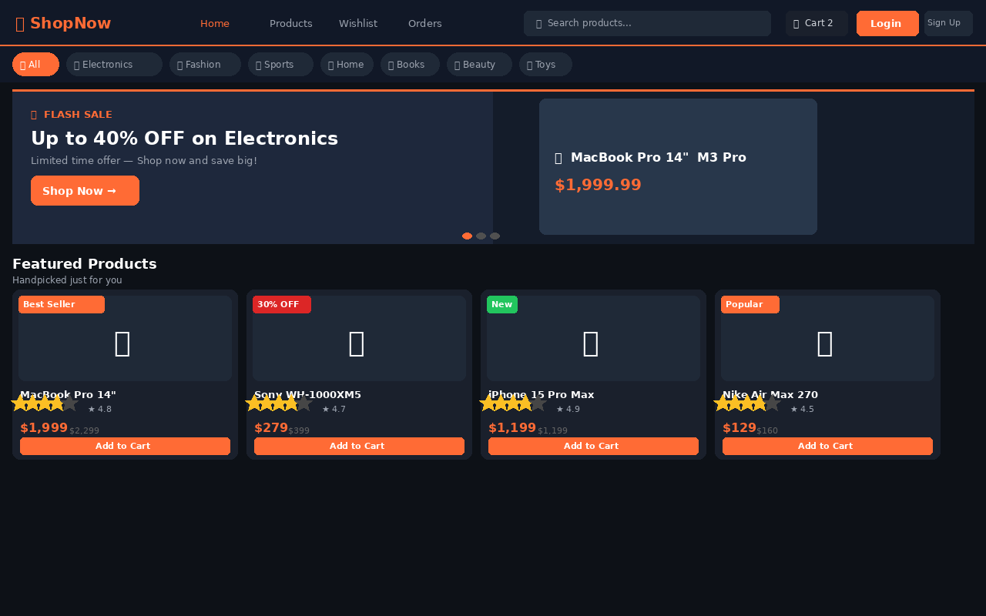
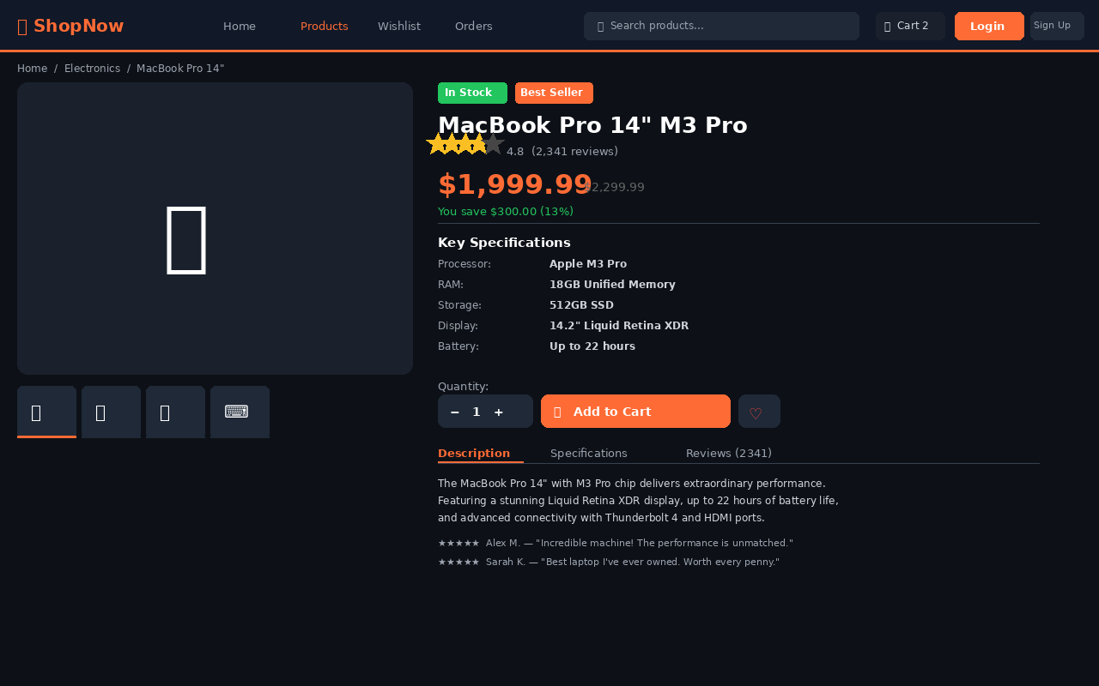
Front-End View
08
Part 1 of 3
localhost/index.html
Homepage — Banner, Categories & Products
Product Detail — Specs, Reviews & Cart
ShopNow — E-Commerce Website | Shabothu Vrishank

Slide 10
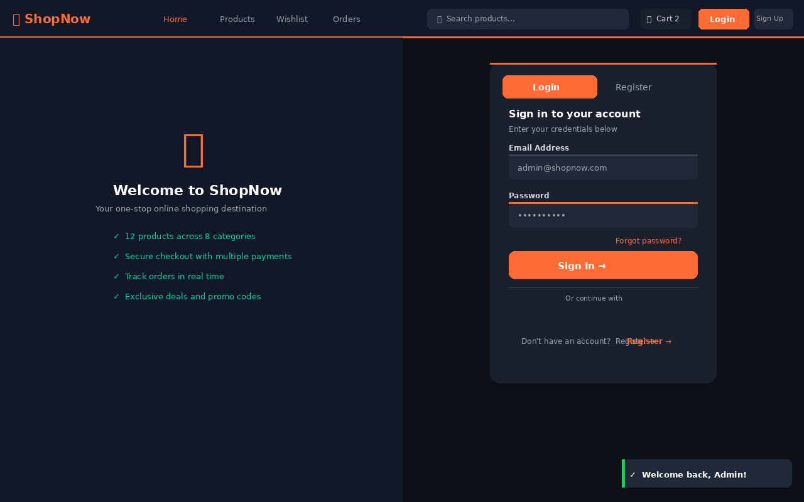
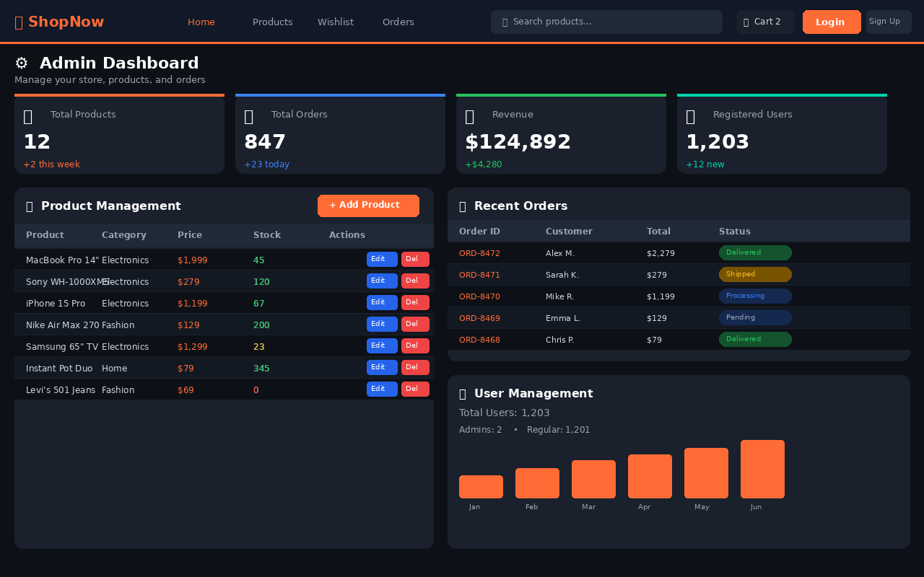
Front-End View
08
Part 2 of 3
Login / Auth — Register, Reset Password
Admin Dashboard — Products, Orders & Users
ShopNow — E-Commerce Website | Shabothu Vrishank

Slide 11
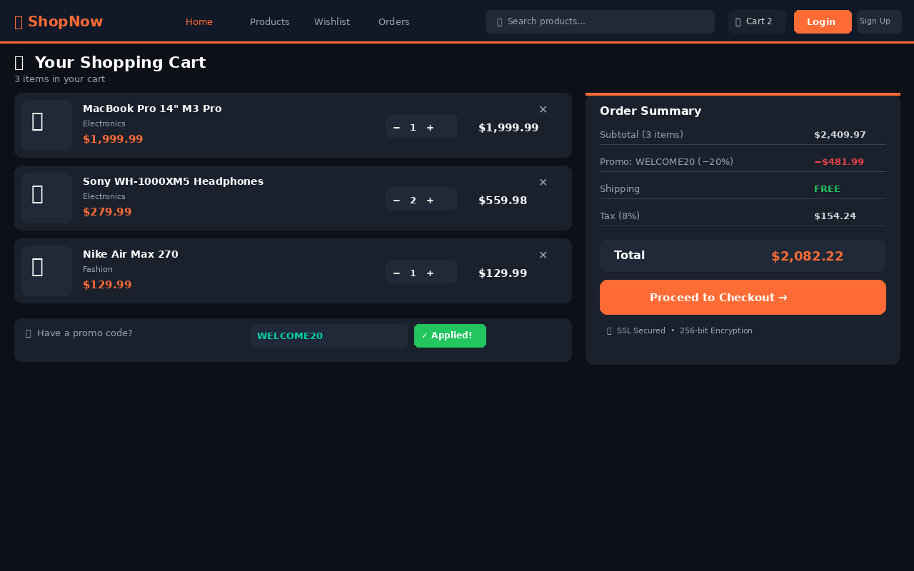
Front-End View
08
Part 3 of 3
localhost/index.html — Cart
Shopping Cart — Promo Code, Qty Control & Secure Checkout Summary
ShopNow — E-Commerce Website | Shabothu Vrishank

Slide 12
Proof of AI Prompts
09
The following AI-generated code screenshots demonstrate how Claude AI was used to build the ShopNow platform from natural language prompts:
Prompt 1 — Homepage Layout
Prompt 2 — Authentication Flow
"Build a full Amazon-like homepage with navbar, hero banner carousel, 8-category grid, and product cards with badges."
"Add a complete auth system: login, register, password reset with form validation and localStorage persistence."
✓ Result: Full navbar + banner carousel + product grid
✓ Result: Login + Register + Password Reset with localStorage
Prompt 3 — Cart & Checkout
Prompt 4 — Admin Dashboard
"Build a shopping cart with qty controls, promo code WELCOME20, tax calc (8%), and a 3-step checkout flow."
"Create an admin panel with revenue stats, product CRUD, order status table, and user management section."
✓ Result: 3-step checkout, promo code, tax & order summary
✓ Result: Stats cards, product table, order & user management
ShopNow — E-Commerce Website | Shabothu Vrishank

Slide 13
References
10
AI Tools
Technologies
Inspiration
Dev Resources
Claude AI (Anthropic)
React (Meta)
Puma
MDN Web Docs
claude.ai
react.dev
puma.com
developer.mozilla.org
All code prompts & generation
UI library via CDN
UI/UX design reference
HTML/CSS/JS documentation
ChatGPT (OpenAI)
Lucide Icons
Nike
VS Code
chat.openai.com
lucide.dev
nike.com
code.visualstudio.com
Alternative AI assistance
Icon library used throughout
Product layout & flow reference
Code editor
Unsplash
Amazon
Google Chrome DevTools
unsplash.com
amazon.com
chrome.google.com
Product images (free use)
Feature set & architecture reference
Debugging & testing
ShopNow — E-Commerce Website | Shabothu Vrishank

Slide 14
Thank You!
ShopNow — E-Commerce Website Project
Website URL
AI Tools Used
Presented by
Open index.html in Browser
Claude AI · ChatGPT
Shabothu Vrishank
HTML5
CSS3
JavaScript
React
Claude AI
VS Code
Built with AI · Presented with Passion
ShopNow E-Commerce Website · Shabothu Vrishank · 2026

